Slide 1

Budget wise AI Based Expense Forecasting Tool -Helping You Plan Your Money, Worry-Free!
Presented by
KAVYA SAMPATHIRAO
NANDI MANGALAM GEERVANI
POOLASETTY CHANDANA
PRATYASHA BASAK
PRIYANSHI JAYANT

Slide 2
contents
ABSTRACT
INTRODUCTION
PROBLEM STATEMENT
OBJECTIVES
WHY AI FOR EXPENSE FORECASTING
FEATURES OF BUDGETWISE
BENEFITS TO USERS
Technologies used
Conclusion

Slide 3
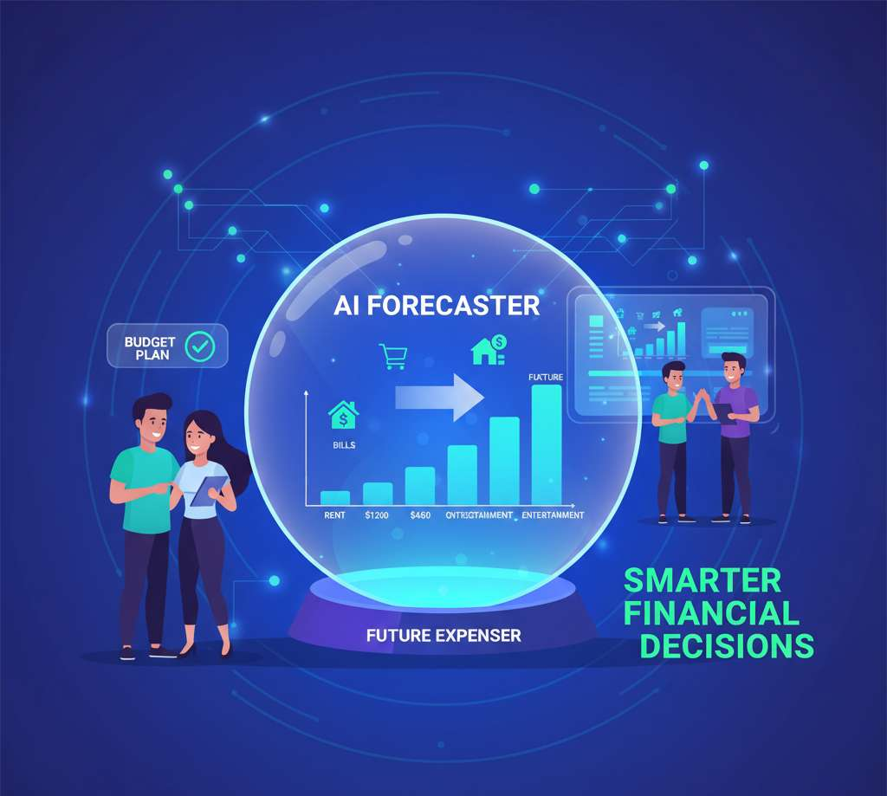

ABSTRACT
Managing money wisely is a challenge for many individuals and businesses. Our project, Budget Wise – an AI-Based Expense Forecasting Tool, aims to simplify financial planning by using Artificial Intelligence to analyze past spending habits and predict future expenses. By understanding how and where money is spent, the system helps users create smarter budgets, avoid overspending, and make informed financial decisions. With personalized insights and predictions, Budget Wise acts like a digital financial advisor — helping users plan their money effectively and achieve better control over their finances.

Slide 4
INTRODUCTION
An AI-Based Expense Forecasting Tool is a smart system that uses Artificial Intelligence to analyze past spending patterns and predict future expenses.
It helps people or businesses plan their budgets, control spending, and make better financial decisions by showing where and how money will likely be spent in the future.
It goes through all your old spending records – how much you spent on groceries, bills, fun stuff, etc.
This prediction helps you create a realistic budget, so you know how much money you'll need for different things.
Both individuals (like you!) and businesses can use it to manage their money better.

Slide 5
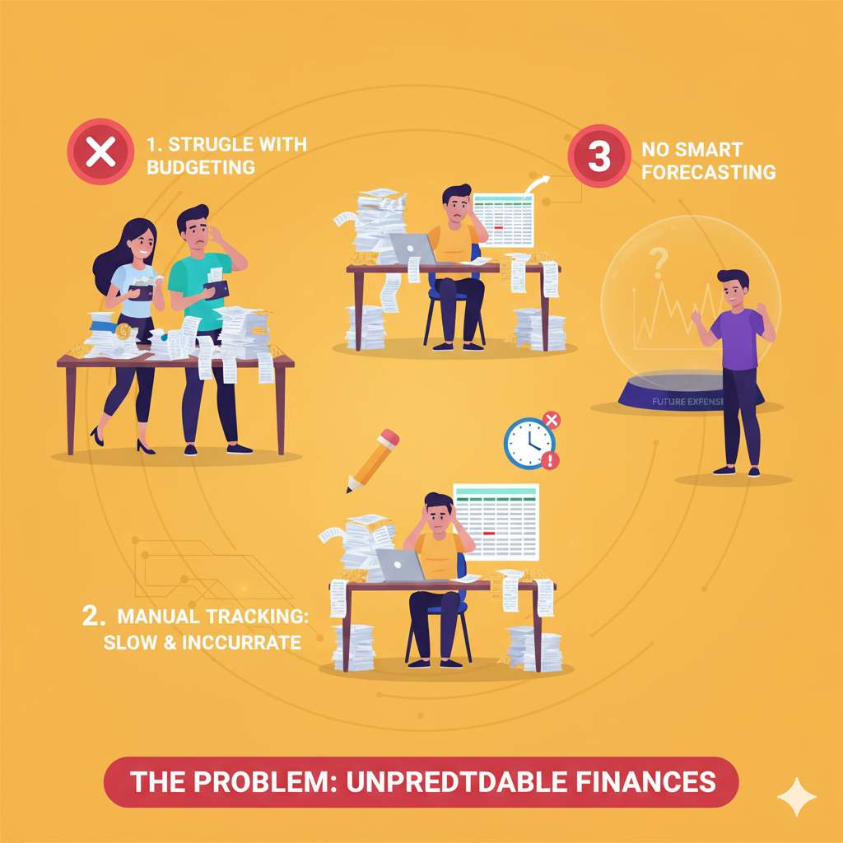
Problem statement
Struggle with Budgeting: Many find it hard to create and stick to budgets because they can't predict future spending. This leads to overspending and financial stress.
Manual Tracking Issues: Recording expenses by hand is slow, error-prone, and often incomplete. It wastes time and gives an unclear picture of finances.
No Smart Forecasting: Existing tools don't intelligently predict future costs based on spending habits. This leaves financial planning reactive instead of proactive.

Slide 6
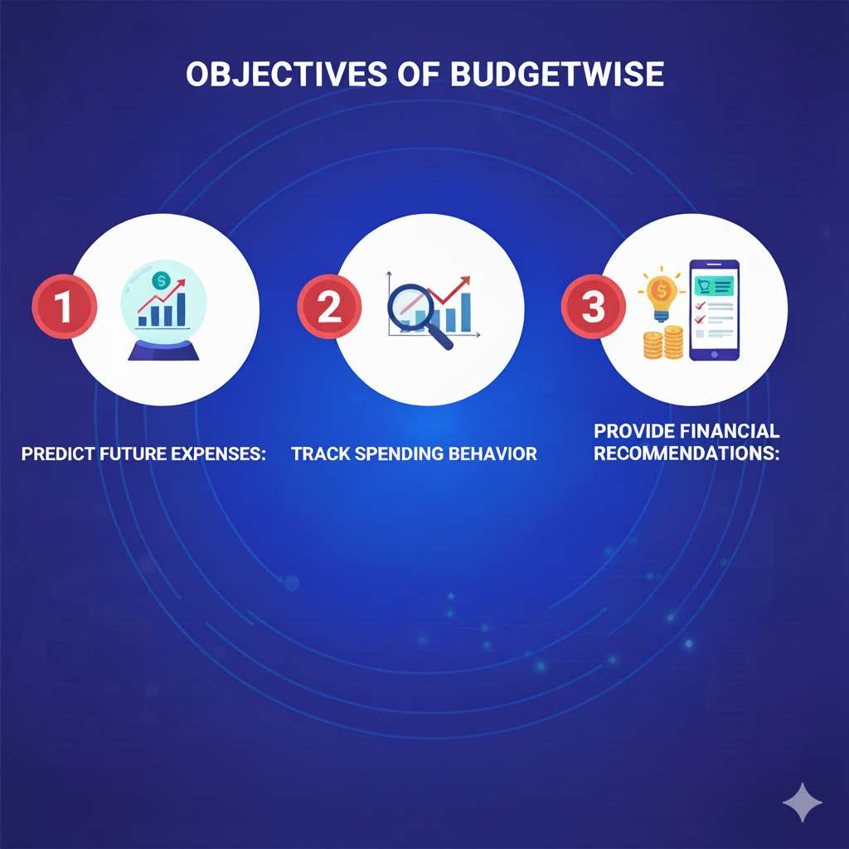
objectives
Accurately forecast upcoming expenditures by analyzing past financial data and identifying patterns.
Automatically monitor and categorize users' spending habits to provide clear insights into money flow.
Offer personalized advice for improving financial health and optimizing spending and saving.

Slide 7
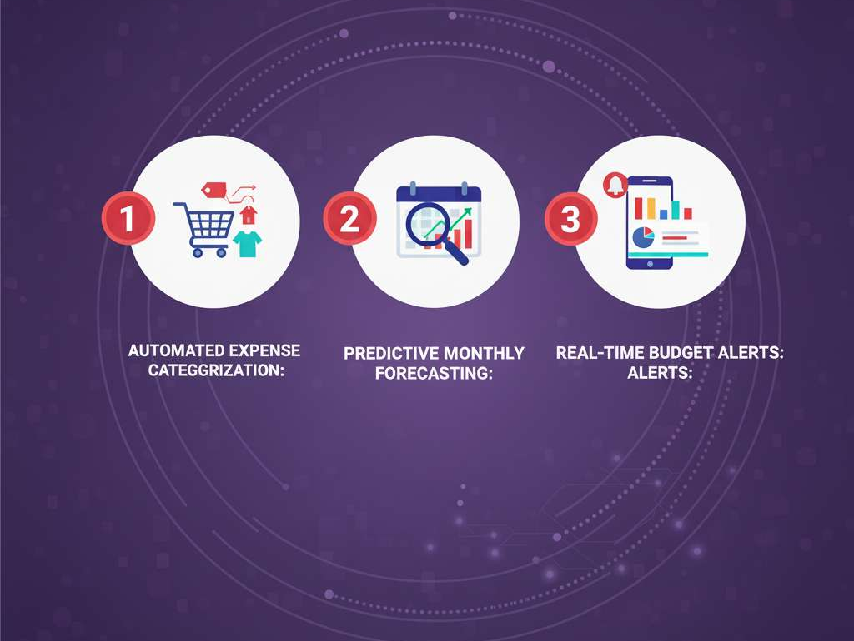
Features of Budget Wise
Automatically sorts transactions into predefined or custom categories for clear financial oversight.
Generates accurate monthly expense predictions based on historical spending patterns and learned behaviors.
Notifies users instantly when they are approaching or exceeding their set budget limits in specific categories

Slide 8
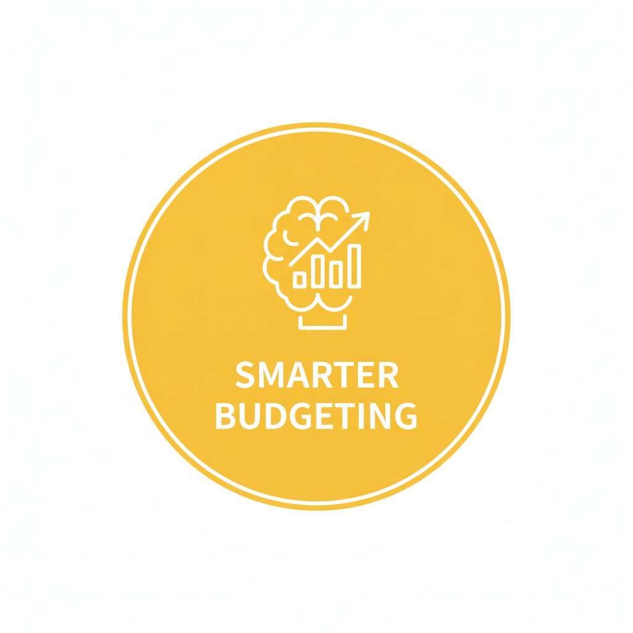
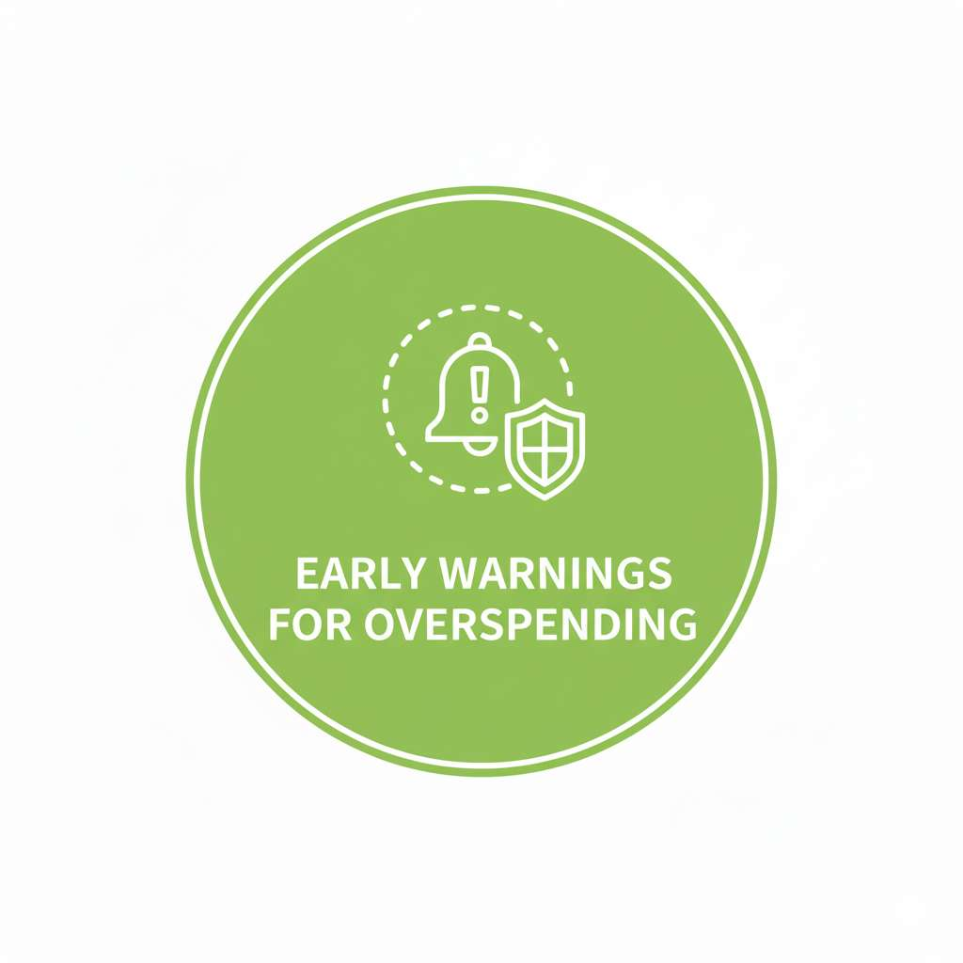

Benefits to Users
Users can create more accurate and realistic budgets based on reliable expense forecasts.
Proactive alerts help users prevent exceeding budgets before it becomes a problem.
Tailored recommendations enable better financial decisions and progress towards goals.

Slide 9
Technologies Used
Python 3
Pandas
Flask
Pyngrok
Plotly.js
HTML5 / CSS3
JavaScript (ES6)
Bootstrap-like Custom CSS Grid
Google Colab

Slide 10
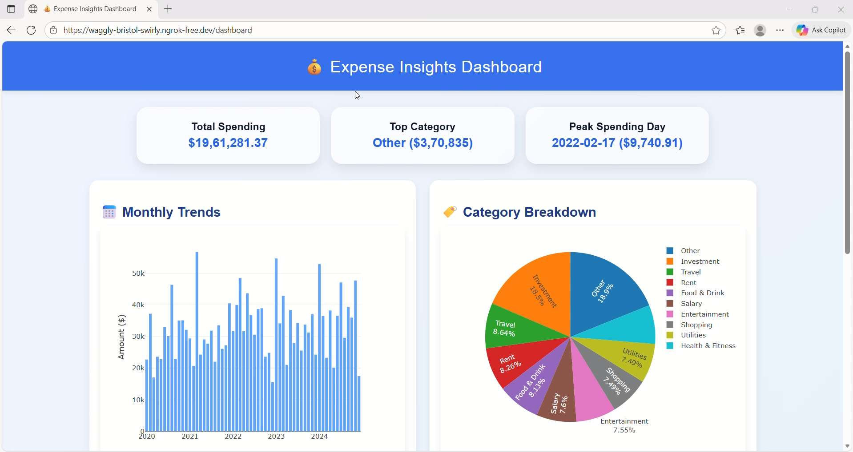
OUTPUT

Slide 11
conclusion
Budget Wise makes money management smarter and easier by using AI to analyze spending habits and predict future expenses.
It helps users plan budgets, control spending, and make better financial decisions with clear insights and visual reports.
By combining data analysis and interactive dashboards, the tool encourages smarter saving and financial awareness. In short, Budget Wise is a step toward stress-free and intelligent financial planning for everyone.

Slide 12
Thank you

